Slide 1
COVID-19 Data Analysis
CS - 306
Arkaprabha Banerjee : 201801408
Shantanu Tyagi : 201801015

Slide 2
Objective
Analyze case studies for specific countries to understand the progression of this epidemic over time
To understand the effect of governmental and socio-economic interventions and vaccinations upon it
To analyze the correlation between awareness among the general population over time with the number of cases and governmental interventions
To qualitatively draw parallels between standard epidemic models in order to understand the progression of the disease and its reproduction number

Slide 3
Datasets Used
1. COVID 19 Case data: https://ourworldindata.org/coronavirus-source-data
2. Government Measures: https://www.bsg.ox.ac.uk/research/research-projects/covid-19-government-response-tracker#data
3. Search behavior — Google Trends tool

Slide 4
Countries considered for study
India
Israel
United States of America
Italy
New Zealand

Slide 5
Missing Data
Missing data was encountered for the number of cases, number of deaths, number of vaccines and the reproduction Number. All their features had consistent data. Upon careful analysis it was found out that the missing data was present in the initial few days when there were no cases or deaths. Hence those fields were replaced by 0.
Missing data of the reproduction rate was filled by taking the value of the closest valid neighbouring field. This was done because reproduction rate is more or less close to its neighbouring values on account of it’s time dependent nature.
For daily deaths, vaccinations and cases there could be often be systemic problems in reporting leading to high fluctuations, Thus a 7 day rolling average value has been chosen to handle such irregularities.

Slide 6
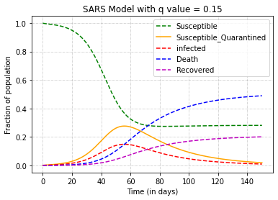
SEIR MODEL
In the SEIR model, we have 4 major compartments: Susceptible, Exposed, Infected and Recovered.
This model assumes that the epidemic ends when the number of infected people become zero.
There exists no closed form expression of the above model. Hence we try to qualitatively analyze the trend for real life scenarios and compare those to representative models.

Slide 7
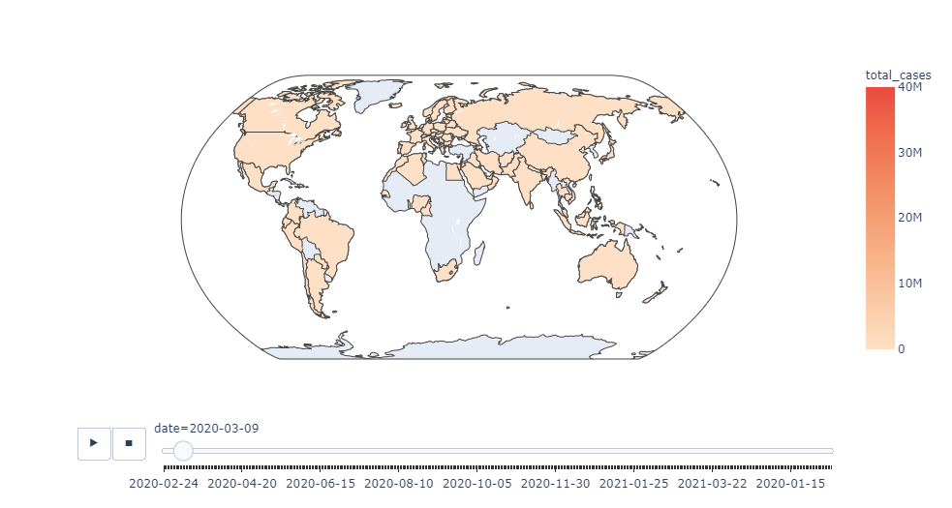
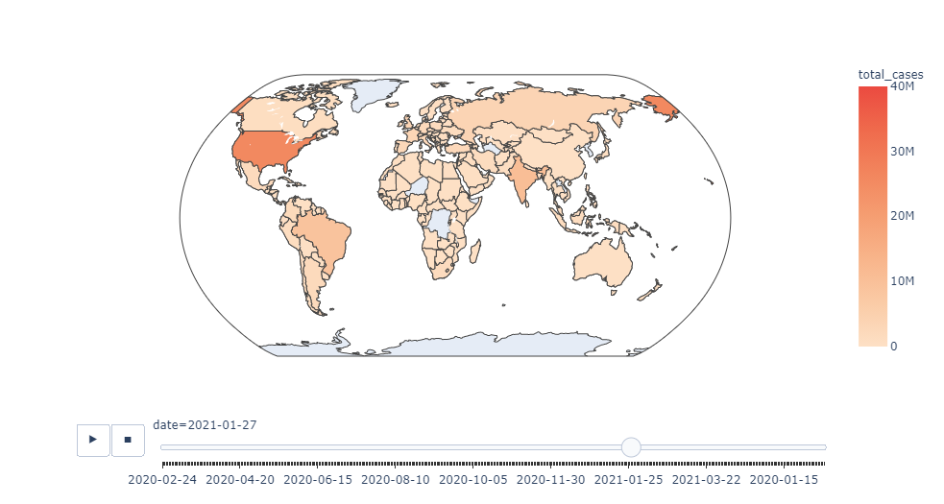
GLOBAL CASES

Slide 8
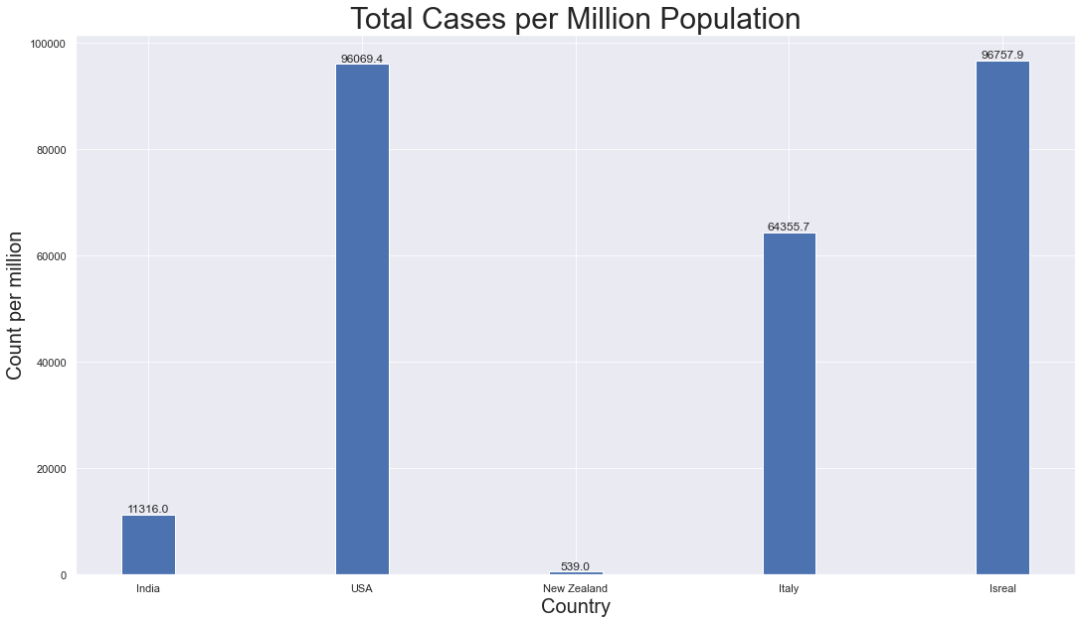
CASES PER MILLION POPULATION

Slide 9
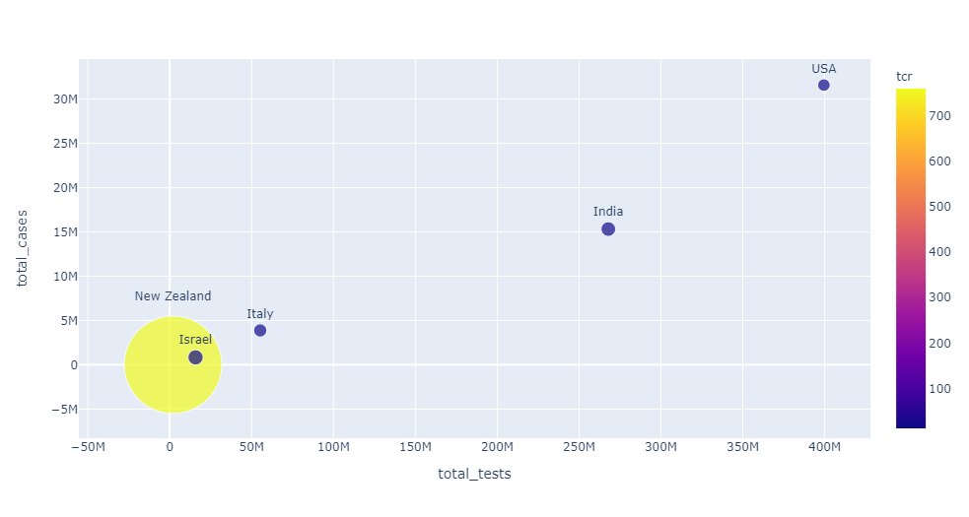
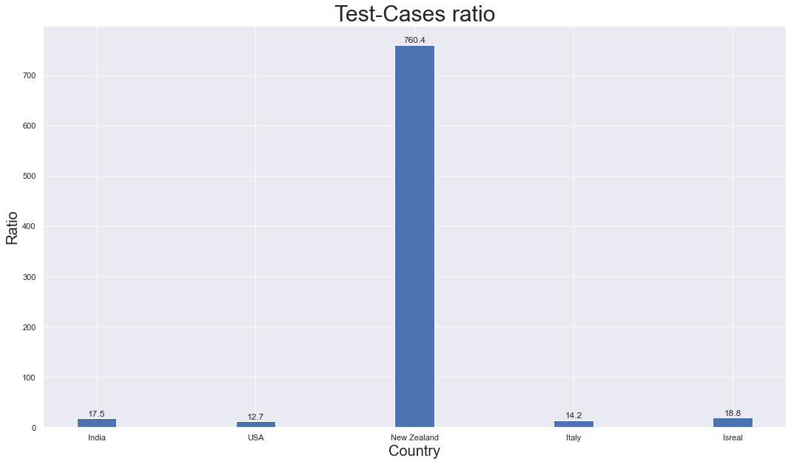
Cases Vs Tests

Slide 10
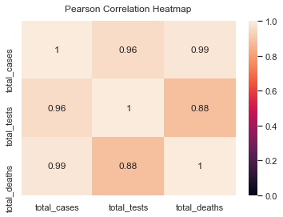
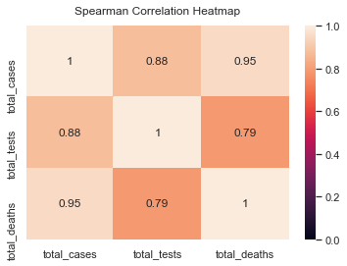
GLOBAL HEATMAPS

Slide 11
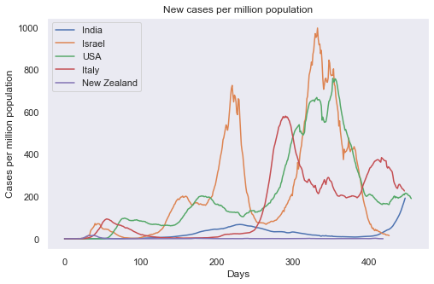
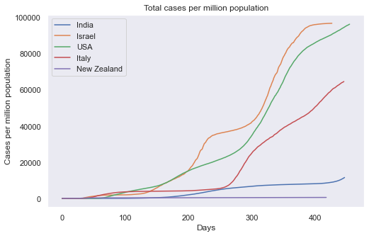
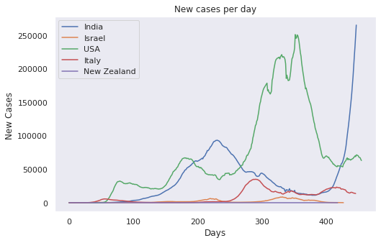
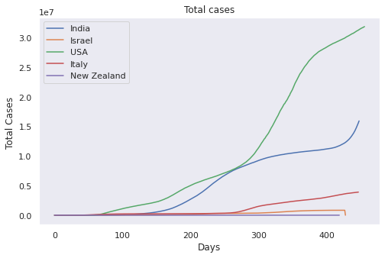
LOOKING AT THE CASES COUNTRY WISE

Slide 12
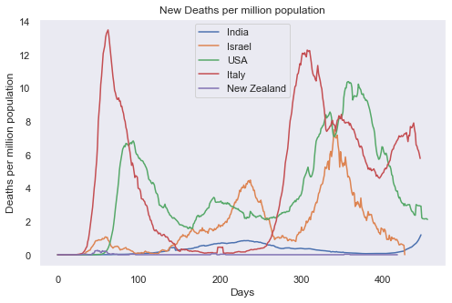
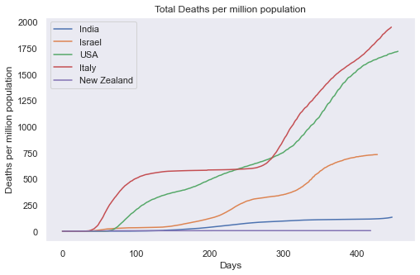
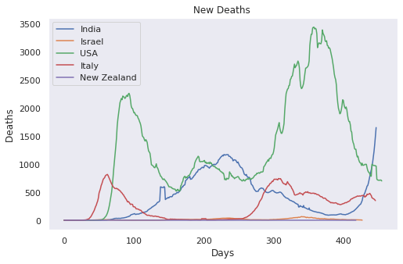
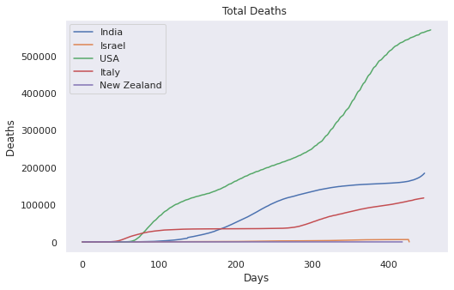
LOOKING AT THE DEATHS COUNTRY WISE

Slide 13
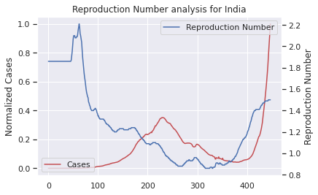
REPRODUCTION NUMBER

Slide 14
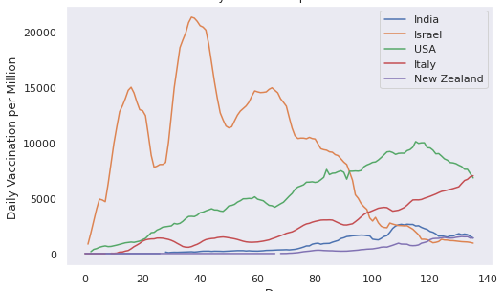
VACCINATIONS

Slide 15
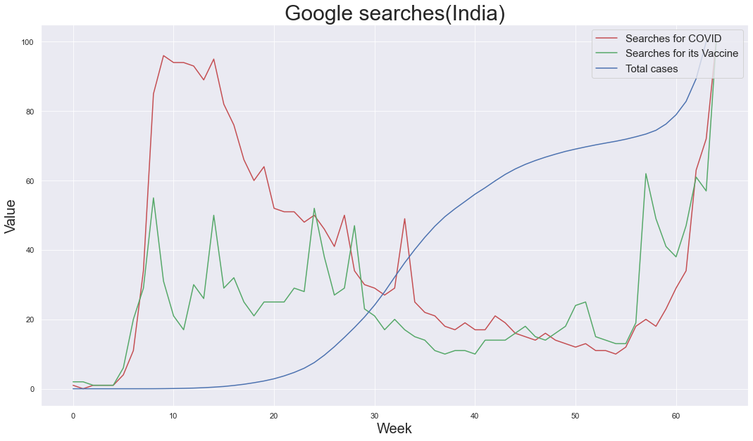
GOOGLE SEARCHES IN INDIA

Slide 16
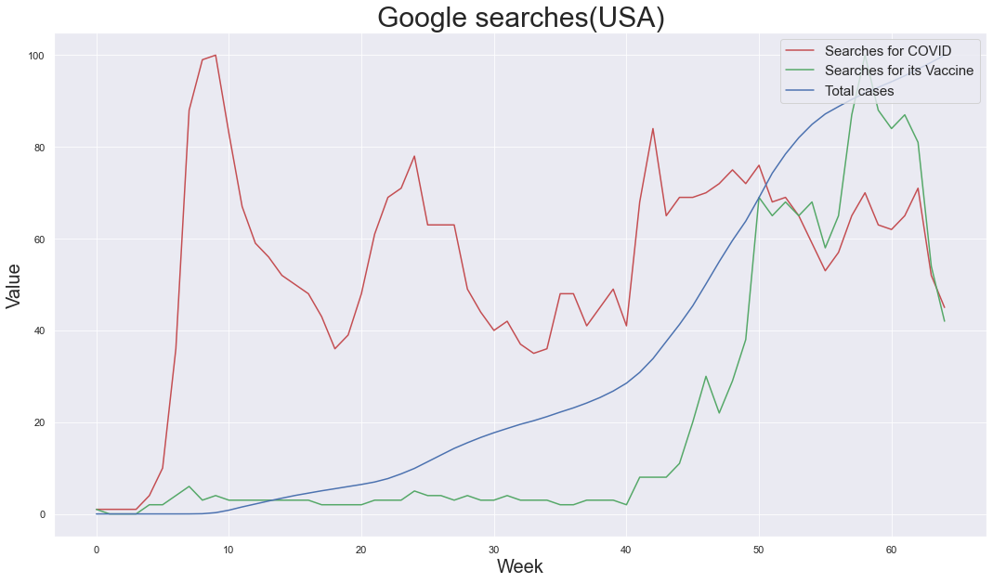
GOOGLE SEARCHES IN USA

Slide 17
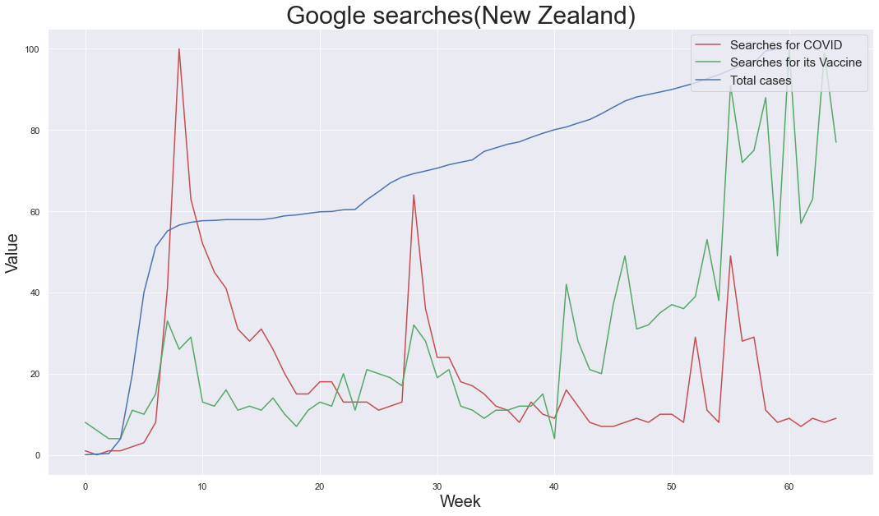
GOOGLE SEARCHES IN NEW ZEALAND

Slide 18
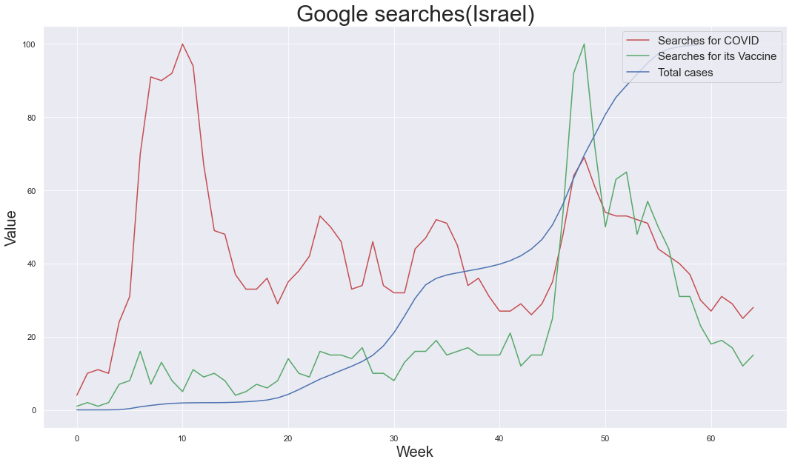
GOOGLE SEARCHES IN ISRAEL

Slide 19
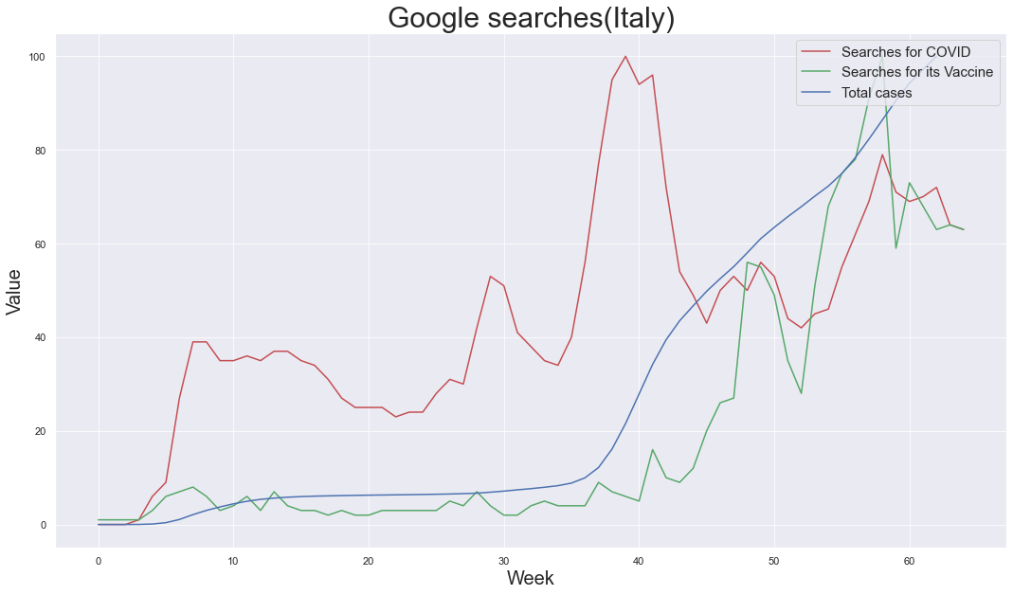
GOOGLE SEARCHES IN ITALY

Slide 20
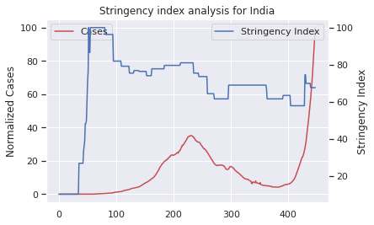
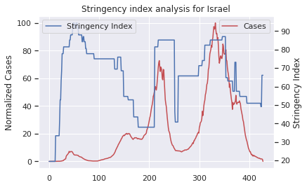
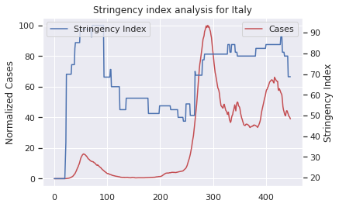
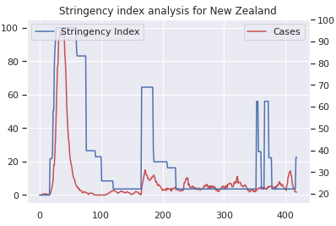
STRINGENCY INDEX ANALYSIS

Slide 21
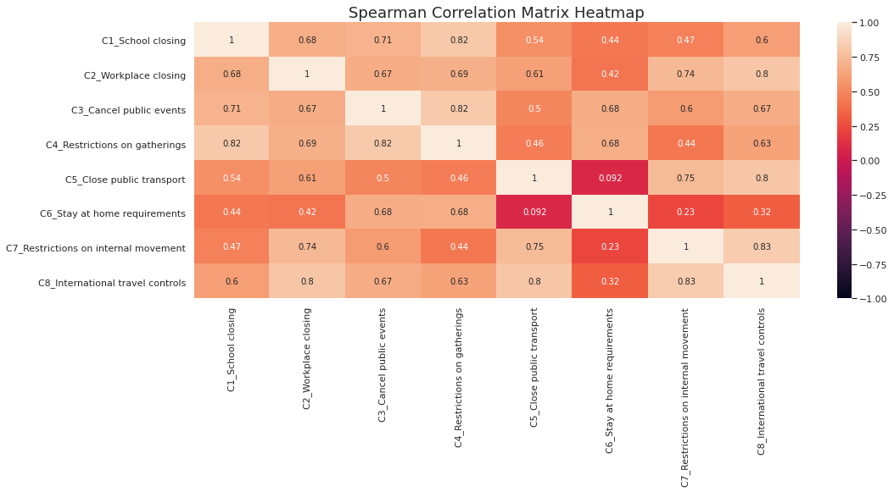
Feature Correlation

Slide 22
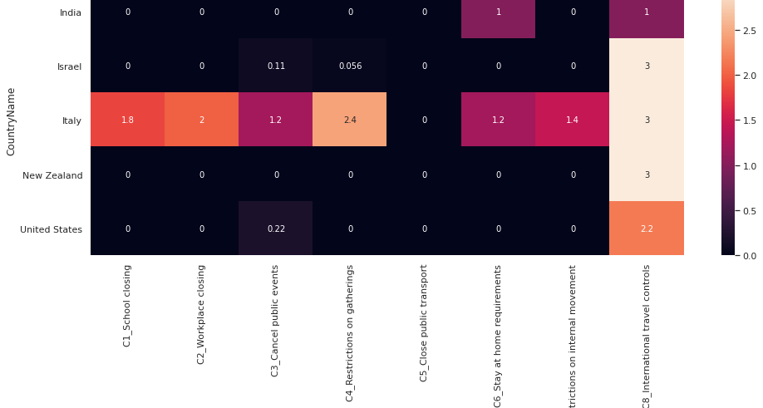
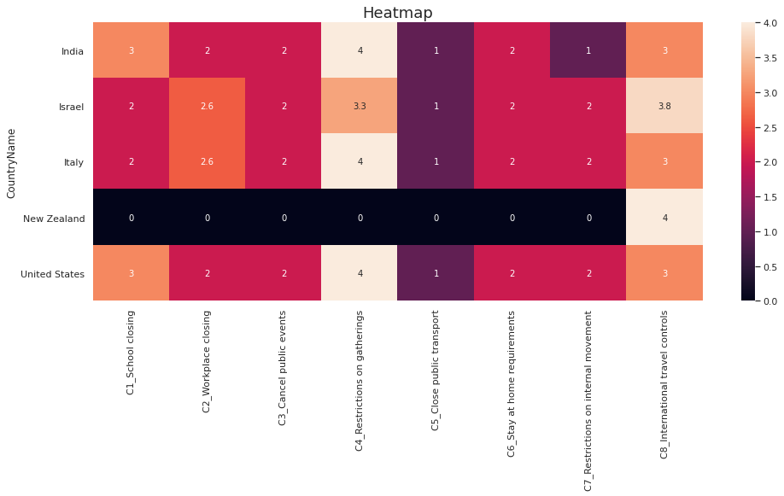
Containment Measures

Slide 23
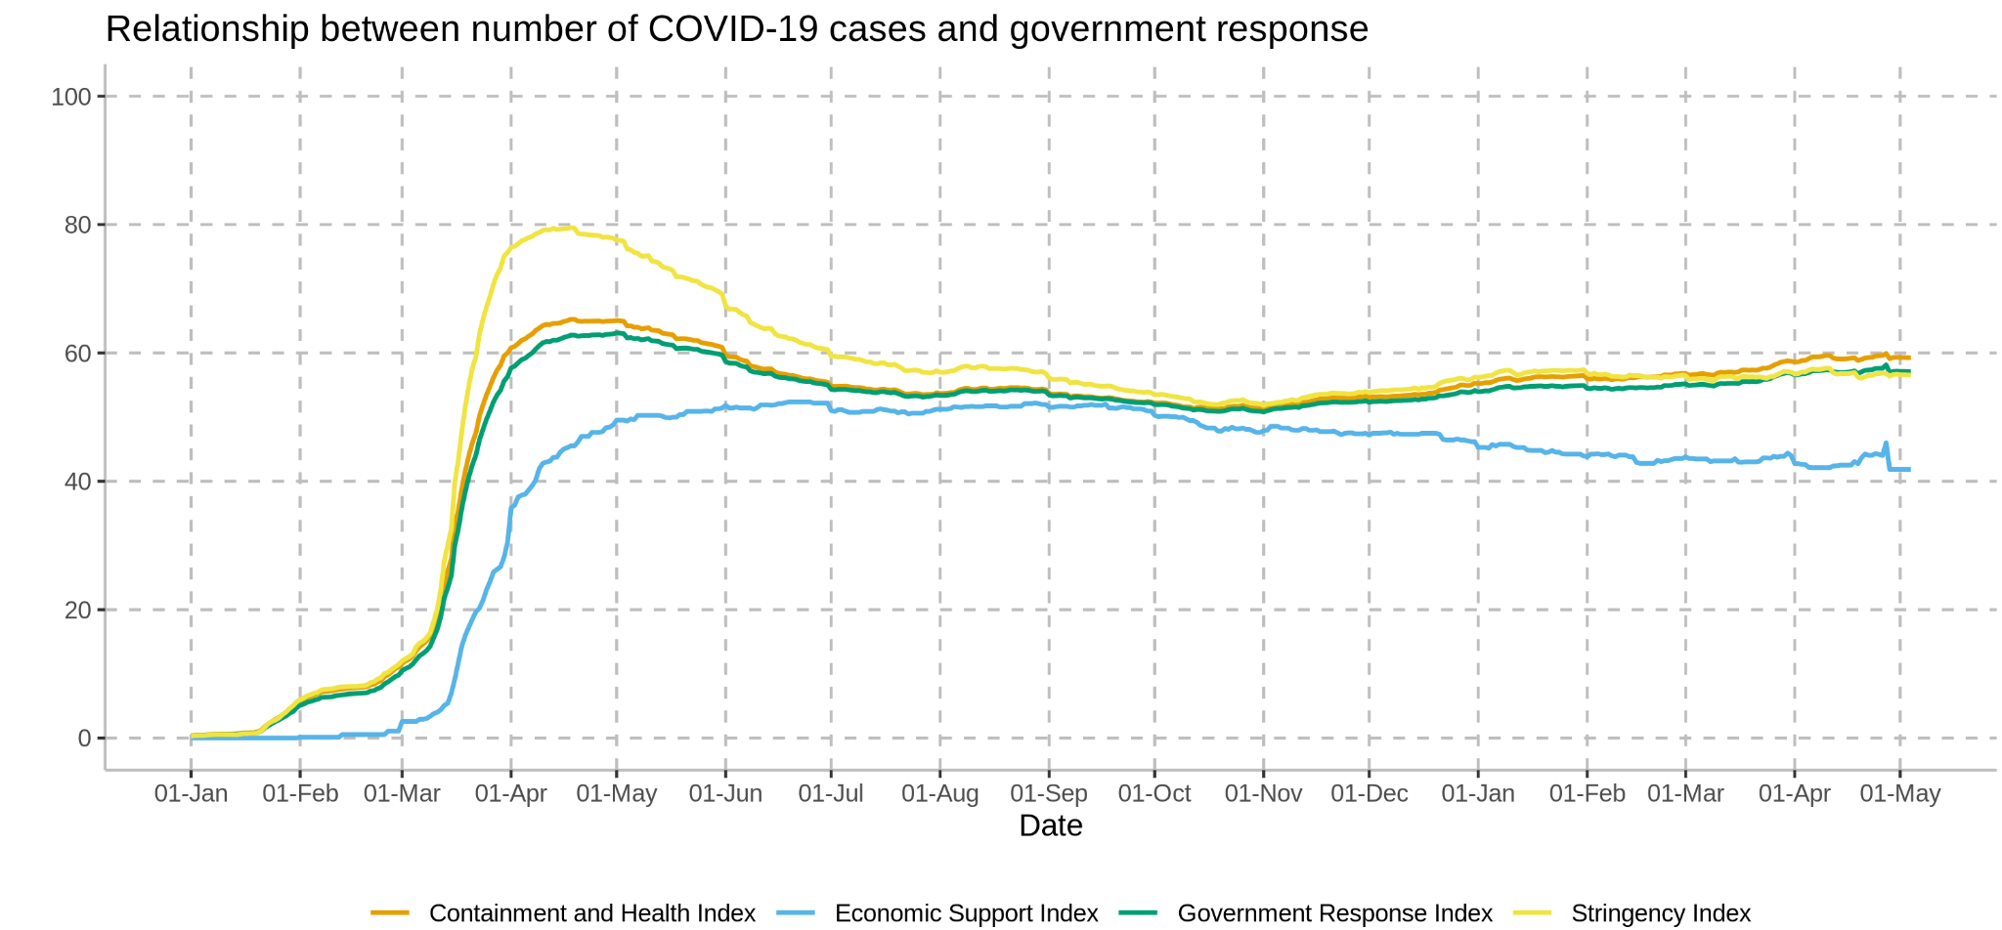
Overall Government Response

Slide 24
CONCLUSIONS

